Slide 1

IT Essentials (CompTIA A+) Ch. 2
Operational Procedures

Slide 2
Overview
Customer Interaction
Tools and safety
Troubleshooting theory

Slide 3


Customer Interaction
Appearance
Appropriate dress
Hygiene
Figure 2.1 Casual
Figure 2.2 Professional

Slide 4
Customer Interaction
Honesty/integrity
Honesty is telling the truth.
Integrity means doing the right thing.
Customer vs. in-house user
Different standards apply to each, customers may fall under company policies while in-house users do not.

Slide 5
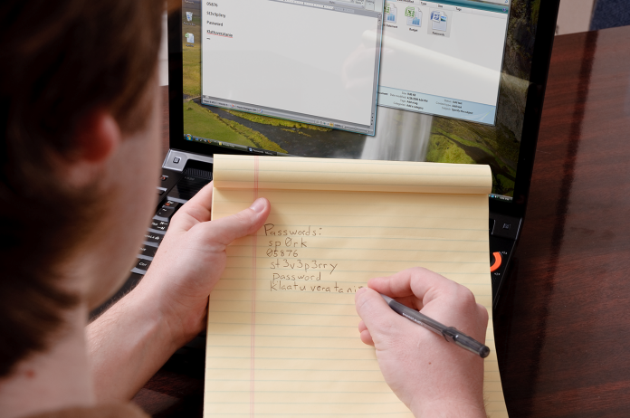
Customer Interaction
Follow the Ethic of Reciprocity (Golden Rule or “don’t do anything that you wouldn’t want done to you”)
Avoid prying into users’
personal files
Avoid learning passwords
Possibly ask the user to change a
password before you leave
Always ask for permission
Figure 2.3 Don’t do this!

Slide 6
Customer Interaction
Dependability/responsibility
What’s the difference?
A responsible person is answerable for the acts he or she does.
A dependable person can be counted on to perform those acts.
Take responsibility for your actions. For instance:
Make sure there’s a dependable backup of any system before you start to work.
Ensure you have customer or company permission
Be familiar with applicable policies and restrictions
Notes:
Show up on time – five minutes early is on time; on time is late.
Take responsibility for the work by having the customer sign/approve the Authorization to Work or Work Authorization form.
Where does the Authorization to Work come from? What if your company doesn’t have one? What if it’s just you? (Answer: make one.)
Backups: Backing up critical data is not your responsibility; however, making sure the customer understands the downside of not doing backups IS your responsibility. Always verify there is a current backup, and if not, offer to make one.

Slide 7
Customer Interaction
Adaptability/versatility
User advocate: A tech only fixes computers; a user advocate supports his or her users.
Be technically and situationally adaptable.
Sensitivity
Be empathetic to your customer’s needs and expectations.
Avoid personal calls or other distractions.
Be culturally sensitive.
Use appropriate professional titles.
Notes:
A good tech can help users in almost any environment.
This might be a good time to discuss the idea of “poking around.”

Slide 8

Customer Interaction
Paperwork
Most companies require a signed Work Authorization to perform work.
Documents the name, billing information, date, and scope of work
May also save one from worry and litigation

Slide 9
Customer Interaction
Assertive communication
Repeat the customer’s problem without being accusatory.
State what is needed to avoid the problem in the future.
Use open and closed ended questions effectively
Examples of assertive communication:
After listening, “So let me make sure I understand” and repeat key points.
Notes:
9

Slide 10
Customer Interaction
Respectful communication
Always ask for permission to begin work.
Actively listen to the customer’s problem.
Don’t interrupt as the customer describes the problem.
Listen and take notes.
Stay professional; don’t take angry customer statements personally.
Avoid outside interruptions on customer time.
What are some examples of
respectful communication?
Notes:
In high-stress situations the tech may be the focus of attention, but keep your feet on the ground.
Ask for permission to leave to take essential calls.

Slide 11
Customer Interaction
Eliciting answers
Use non-accusatory communication.
Not, “What did you do?”
Instead, “When did it last work?” or “Has it worked in the past?”
Ask fact-seeking questions to stay on track.
Explaining what you’re doing
Avoid jargon, acronyms, and abbreviations.
Use analogies and visual aids when possible.
Notes:
Discuss the difference between jargon and techno-babble
Jargon is truthful but inconsiderate and makes you seem insecure. Techno-babble is dishonesty.
For fun, see if any of your students can do good techno-babble.

Slide 12
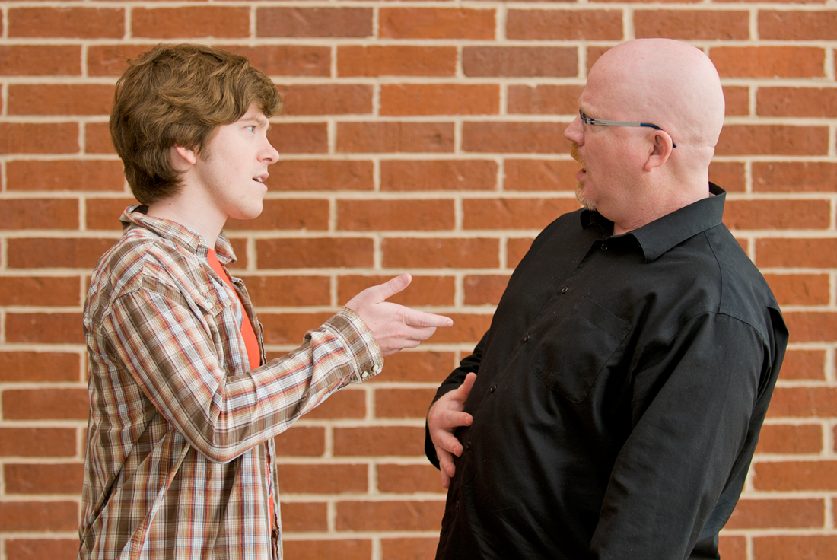
Customer Interaction
Figure 2.4 Never accuse!

Slide 13

Customer Interaction
Figure 2.5 Keeping it friendly

Slide 14
Customer Interaction
Expectations and follow-up
Timeline: How long is this going to take?
Provide a best estimate, not a guarantee.
If the estimate changes, let the customer know ASAP.
Know the options
Provide alternatives and let the customer decide.
Documentation
Always the document time, day, problem, and solution.
Always offer the customer any replaced parts.
Follow-up
Confirm that the customer is happy a day or two later.

Slide 15

Customer Interaction

Slide 16
Tools and safety
Electrostatic discharge (ESD) is the passage of a static electrical charge into your PC or a PC component such as a RAM stick.
ESD happens when two objects with different potential of static electricity come into contact
Static electricity can destroy sensitive parts of a PC and is more prevalent in dry,
cool environments.
Notes:
16

Slide 17
Tools and safety
It takes 3000 volts for a person to feel ESD.
10,000 volts of ESD before it hurts.
As little as 30 volts can
damage components.
Notes:
17

Slide 18
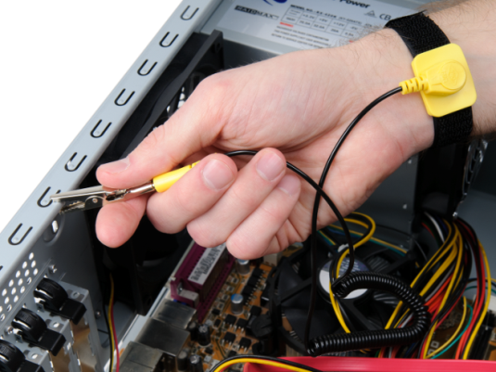
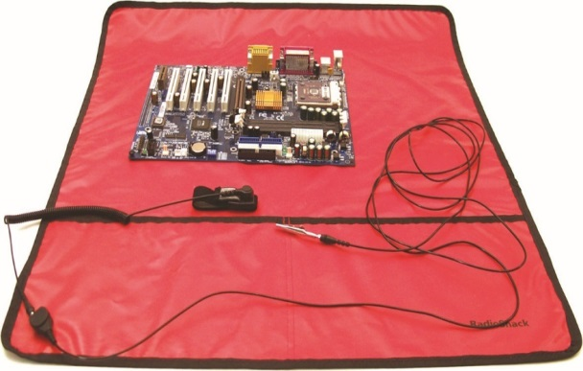
Tools and safety
Antistatic wrist strap
Keeps you and the PC at the same electrical potential to prevent ESD
Antistatic mat
Used temporarily to place parts taken out of the PC
Some of these antistatic devices use tiny resistors.
Figure 2.6 Anti-static
wrist strap in use
Figure 2.7 Anti-static
wrist strap and mat
combination
Notes:
18

Slide 19
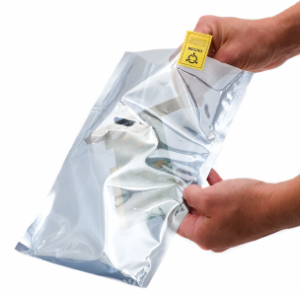
Tools and safety
Antistatic bags
Specially designed bags that shed
static electricity when touched
Should be used to store
electrical components from
your PC
Figure 2.8 Anti-static bag

Slide 20
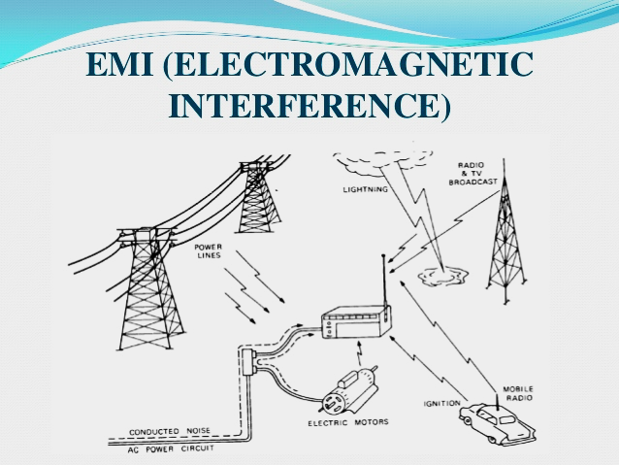
Tools and safety
EMI is two or more magnetic fields interfering with each other.
Not as dangerous as ESD
Can cause permanent damage to
some components and erase data on
some storage devices
Next Slide
Notes:
Before working on a computer without proper antistatic tools, take a moment to touch the power supply every once in a while as you work—I’ll show you where it is in Chapter 3— to keep yourself at the same electrical potential as the computer. Although this isn’t as good as a wrist strap, this self-grounding is better than nothing at all.

Slide 21
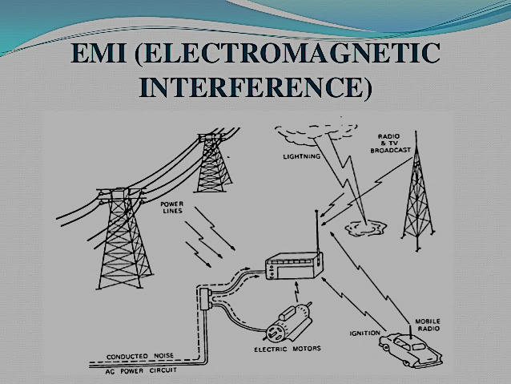
Notes:
Before working on a computer without proper antistatic tools, take a moment to touch the power supply every once in a while as you work—I’ll show you where it is in Chapter 3— to keep yourself at the same electrical potential as the computer. Although this isn’t as good as a wrist strap, this self-grounding is better than nothing at all.

Slide 22
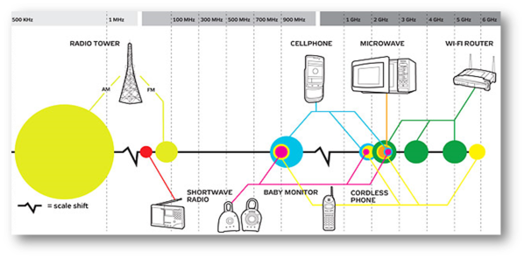
Tools and safety
RFI involves radio waves that interfere with electronics.
Will not destroy, but can disrupt communication
PC speakers and wireless networks, as well as other components, are susceptible to RFI.
Next Slide
Notes:
You see RFI a lot with modern wireless networking. Cordless telephones often use the same radio frequency as WiFi networks, thus creating interference.

Slide 23
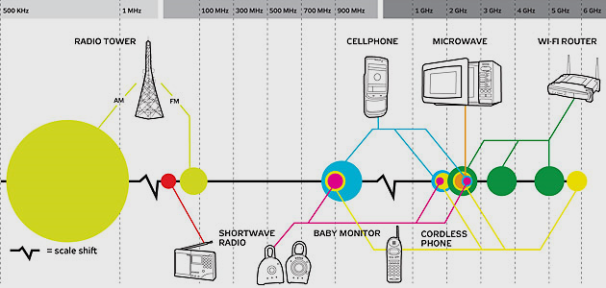
Tools and safety
Notes:
You see RFI a lot with modern wireless networking. Cordless telephones often use the same radio frequency as WiFi networks, thus creating interference.

Slide 24

Tools and safety
IT techs live in a dangerous world and need to consider personal safety issues.
Here are some threats we face:
Network closet clutter.
Heavy and awkward lifting.
Hot, hazardous, or electrified items.
Here are some best practices:
ALWAYS remove power FIRST.
Remove jewelry (secure loose clothing, long hair) before preforming hardware repairs

Slide 25
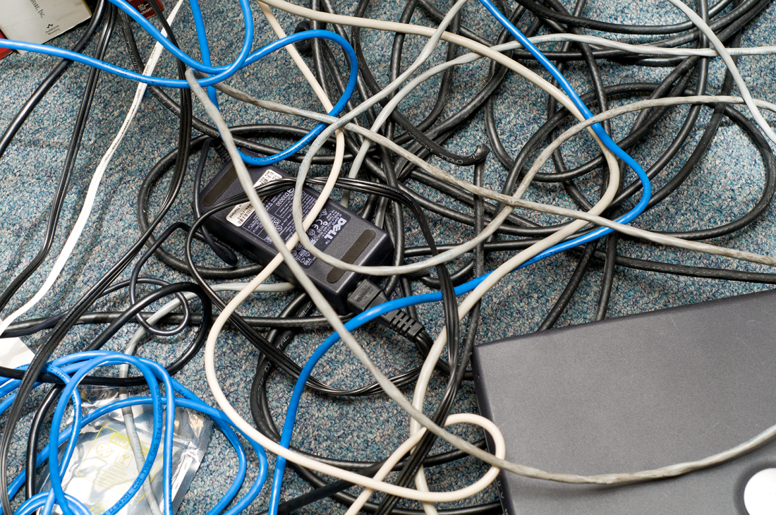
Tools and safety
Alert a building supervisor when cable messes are a dangerous tripping hazard.
Notes:
Cable messes such as these are dangerous tripping hazards.

Slide 26

Tools and safety
Lift heavy items with your legs, not back.
Watch for trip hazards.
Figure 2.10 What a strange, bad trip it’s been.

Slide 27

Tools and safety
Hot or hazardous:
Monitors, printers, or computers
Figure 2.11 Checking for hot cooling fans

Slide 28
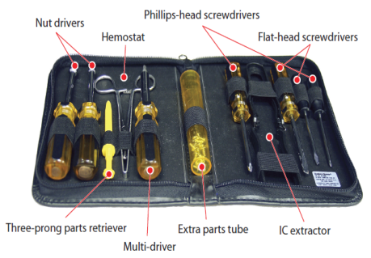
Tools and safety
The basic tech toolkit contains a Phillips-head screwdriver and a few other items
It’s a good idea to also include:
Magnifying glass
Small flashlight
Plastic tweezers
Small plastic wedge
Any additional suggestions?
Next Slde

Slide 29
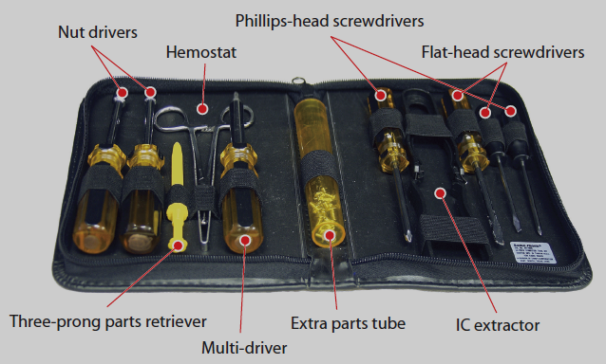
Tools and safety
Figure 2.12 Typical technician toolkit

Slide 30

Tools and safety
There are Software tools to troubleshooting almost every scenario.
Tools for scanning for malware (malicious software, such as viruses)
Tool for checking memory,
and other diagnostic scenarios.
Examples?

Slide 31

Tools and safety

Slide 32
Troubleshooting Theory
CompTIA clearly defines their vision of Troubleshooting Theory into six logical steps.
Troubleshooting systematically results in efficient diagnosis and repair:
More accurate diagnosis
Timely diagnosis
Saves money
Reduces down time
Increases proficiency
Notes:
32

Slide 33

Troubleshooting Theory
Ask the user about
recent changes and
perform backups before
“fixing” anything.
Don’t be accusatory.
Offer to perform a backup
of all critical information.
Identify Establish theory Test Resolve Verify Document
Figure 2.13 Tech asking nicely

Slide 34
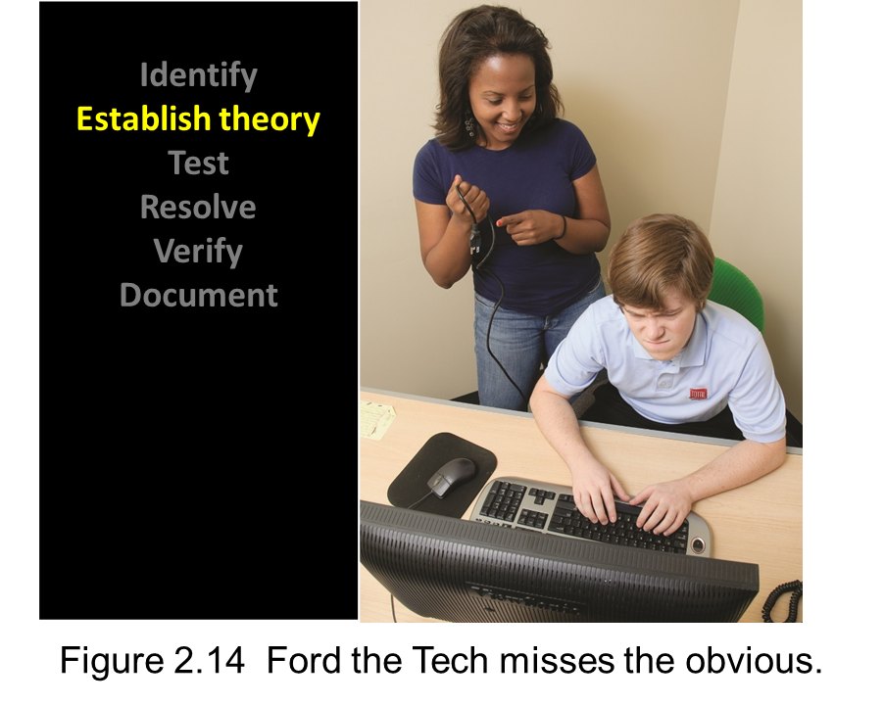
Troubleshooting Theory
Use information gathered to produce a theory.

Slide 35
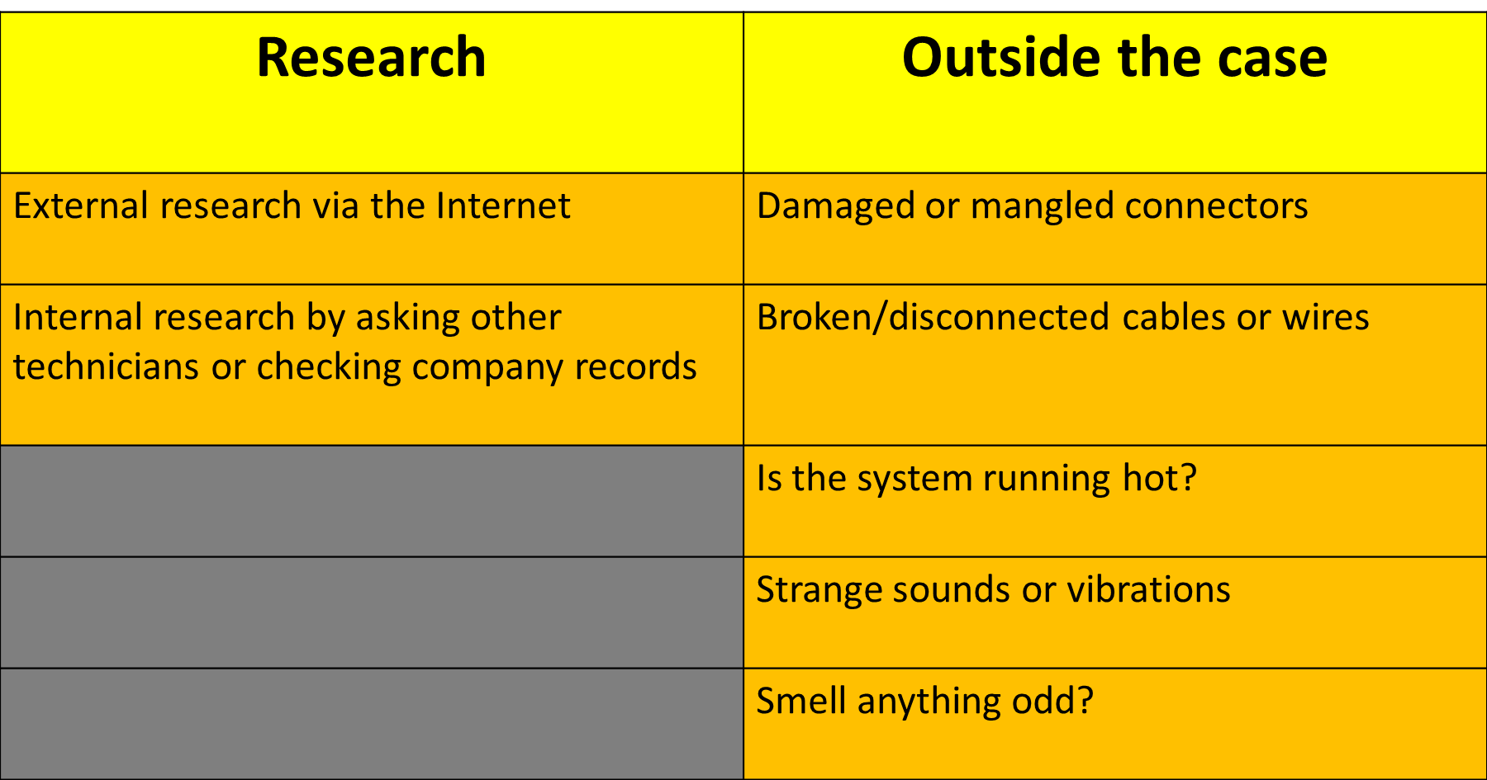
Troubleshooting Theory
Don’t overlook obvious solutions; apply your knowledge of the computing process

Slide 36

Troubleshooting Theory
Test the theory to see if it fixes the problem.
Testing will verify that something is broken.
If a theory is not confirmed, develop a new theory.
Identify Establish theory Test Resolve Verify Document

Slide 37

Troubleshooting Theory
Once you’ve identified the cause, determine how you can implement corrective actions.
If it’s beyond your skills, escalate the problem.
Don’t be afraid to ask for help.
Identify Establish theory Test Resolve Verify Document
Figure 2.15 It’s OK to asks for help.

Slide 38

Troubleshooting Theory
Verify full system functionality.
Watch the customer use the system for a few minutes.
As a LAST action,
educate the customer
on how to avoid this
problem.

Slide 39
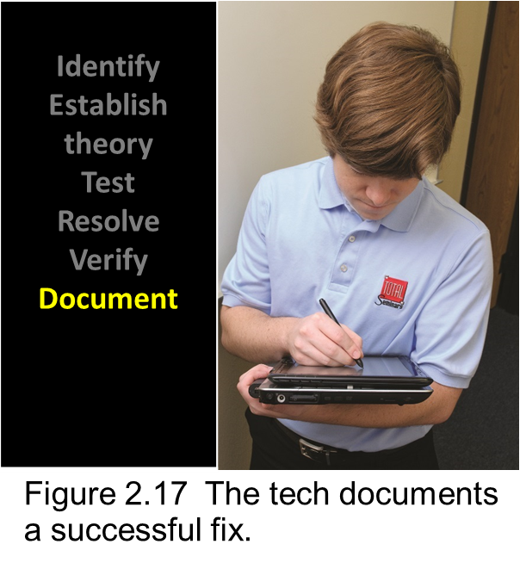
Troubleshooting Theory
The last step is to document.
An incident report for an accident provides details of what happened and where it happened.
Allows you to track a machine’s history, enabling long-term decisions.
Also helps fellow technicians if they have to follow up.

Slide 40
Troubleshooting Theory
MEMORY AID NEUMONIC
1.IDENTIFY THE PROBLEM | IS
2.ESTABLISH A THEORY | EVERY
3.TEST YOUR THEORY | T
4.RESOLVE THE PROBLEM | REX
5.VERIFY/VALIDATE THE FIX | VERY
6.DOCUMENT | DANGEROUS

Slide 41

So, What are the six Trouble Shooting Steps?

Slide 42
Summary
Path of the PC Tech
Customer Interaction
Tools and safety
Troubleshooting theory

Slide 43


